Slide 1
KES-SMART: KES STUDENT MONITORING APPLICATION WITH REAL-TIME QR AND SMS NOTIFICATIONS

Slide 2
Group members
Krystel joy ligo
Althea swane DAANOY
Lovelyn grace londres
Noel carian jr.

Slide 3
Background of the Study
Technology has witnessed impressive evolution in the past few decades, which has transformed various aspects of human life, especially in work and education. One major development in education is the improvement in how schools manage student data. In Kalandagan Elementary School, teachers still use traditional methods such as roll calls and paper-based attendance sheets. These manual processes are time-consuming, prone to human errors, and do not provide immediate access to information. To address these challenges, a QR code-based attendance system is proposed to streamline the process by allowing students to scan their codes upon entering and leaving the school premises, automatically generating SMS notifications to parents about their children’s arrival and departure.
According to Li (2025), time management has become an essential factor in modern life, leading to the preference for automated systems over manual processes. The Internet of Things (IoT) plays a major role in advancing such automation across various sectors, including education. RFID technology, widely used in agriculture, transportation, and sales, can also be applied to automate attendance-taking in schools. Manual attendance methods are often time-consuming and error-prone, and they may result in inaccuracies or even misconduct. Implementing an IoT-based RFID system can significantly enhance efficiency and accuracy in attendance recording (Li, 2025).

Slide 4
Inaccurate or delayed attendance recording can create confusion between students, teachers, and parents, potentially affecting a student’s grades and academic standing. Outdated manual systems slow down administrative tasks and hinder accurate monitoring of attendance. In schools, checking attendance is a daily activity conducted to ensure that students are present in class. Common manual methods such as roll calling, class records, and attendance sheets often suffer from inefficiency and errors. These issues highlight the need for a more reliable, technology-driven solution.
In response to these challenges, the researchers propose a QR code-based student attendance monitoring system. This system will allow for the efficient and accurate recording of student attendance, reducing human errors and saving valuable time. The automated process will also provide real-time access to attendance records, benefiting both school administrators and parents. By replacing the manual system with this digital solution, schools can improve accuracy, efficiency, and communication between all stakeholders

Slide 5
Objectives of the Study
General Objective:
This study generally aims to develop and evaluate the “KES-SMART: KES STUDENT MONITORING APPLICATION WITH REAL-TIME QR AND SMS NOTIFICATIONS”

Slide 6
Specific Objectives:
This study specifically aims to:
1. Manage user’s information and account.
2. Provide an interface for (Admin, Teacher, Student and Parent).
3. Develop a mobile application that allows teacher to efficiently monitor student attendance using QR code scanning.
4. Allow parent to view their attendance automatically.
5. Provide a feature that the system can evaluate automatically
6. Integrate an SMS notification system to instantly notify the parents.
7. General reports such as;
7.1. List of students
7.1.1. Per section
7.2. Student information sheet
7.3. QR Code
  7.4. Attendance Record
7.4.1. Per Section
7.4.2. Per Student
8. Evaluate the system in terms of;
8.1. Functionality
8.2. Accessibility
8.3. Accuracy
8.4. Security

Slide 7
Significance of the Study
The Administrators
This study was beneficial to the administrator by giving them a better way to manage student attendance records. Instead of checking logbooks or waiting for reports, they could access everything in one place online. It saved time, avoided errors, and helped them keep track of important data like who is attending classes and student reports.
The Teachers
To the teachers who struggles regarding of monitoring the attendance of their attendance to control the problem encountered using traditional manual methods it is very useful to easily access and calculate the attendance records of their students and to monitor the absences. It also helps teachers to easily access attendance records without any manual searching allowing teachers to focus more on teaching.
The Students
To the student implement of an attendance monitoring system ensures that student’s attendance is accurately recorded. This helps in maintaining transparency, ensuring accountability, and encouraging students to be more responsible for their attendance.
The Researchers
This study is beneficial and benefited the researchers with knowledge about attendance monitoring. It enhances the researchers understanding of management, scheduling system and assistance services process. The researchers gained actual information on how the system works.

Slide 8
The Future Researcher
Future researchers can use this study as a reference for similar projects or for further improvements in attendance monitoring system. It provides a framework for developing efficient, technology driven solutions in educational institutions, ensuring the systems continuous improvement and wider.
The School
The system allows for better student attendance tracking, reducing errors and inefficiencies. It provides administrators with accurate data to make informed decisions, interventions, and school management strategies.
To the Parents
Timely and accurate notification about their child's attendance to ensure the safety of their children.

Slide 9
Scope and Limitation of the Study
This study focuses on the development of KES: Student Monitoring Application with Real-Time QR and SMS Notification for Kalandagan Elementary School. The main goal is to automate the student attendance process and improve communication between the school and parents through real-time SMS updates. The system is specifically designed for Grade 1 to Grade 6 students and aims to assist school staff in managing daily attendance more efficiently. The primary beneficiaries of the system are students, parents, teachers, and school administrators.
The study centers on a QR code-based attendance system, where each student is issued a unique QR code integrated into their school ID. When a student arrives at school, the QR code is scanned by a teacher and the system records the time and date of arrival. Immediately after validation, an SMS notification is sent to the student’s parent or guardian, confirming their attendance. This real-time alert allows parents to stay informed and involved in their child’s daily school attendance.

Slide 10
The system includes user management features, allowing different roles such as administrators, teachers, students, and parents, each with designated access rights. The administrator is responsible for registering students, encoding relevant details such as name, ID number, age, gender, address, and contact information. Once the student is registered, the system automatically generates a QR code for attendance tracking. The administrator can also manage records of sent SMS notifications, including the recipient, message content, date, and time.
The scope of the study is limited to attendance monitoring upon student arrival only, and does not include departure tracking or behavior monitoring throughout the day. The system relies on stable internet and mobile network connectivity for real-time SMS delivery, and assumes that parents have access to mobile phones and are able to reply to messages. It is also limited to use within Kalandagan Elementary School and does not support students outside the specified grade levels. Additionally, the system does not include biometric scanning or other advanced identification methods.

Slide 11
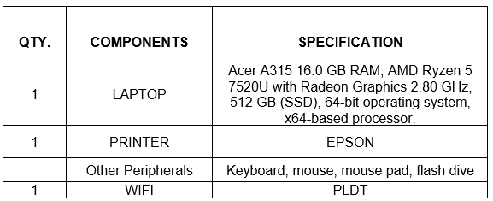
Methodology
The following materials were identified and acquired by the researchers to ensure that the development process will not be delayed.
Table 1: Hardware Requirements

Slide 12
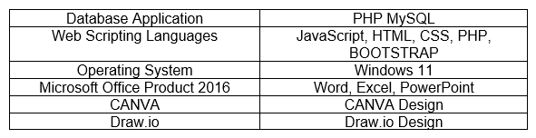
Table 2: Software Requirements

Slide 13
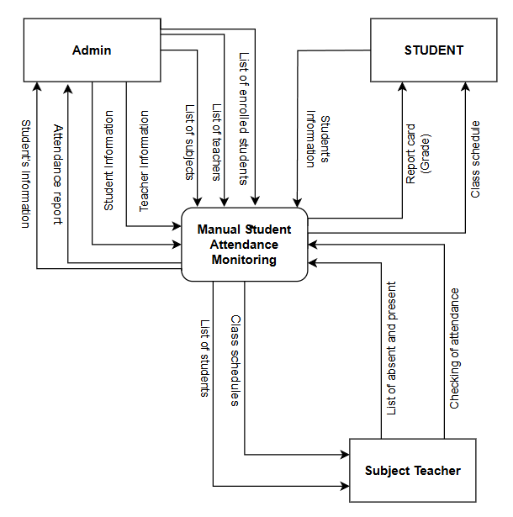
Context Diagram (Existing System)

Slide 14
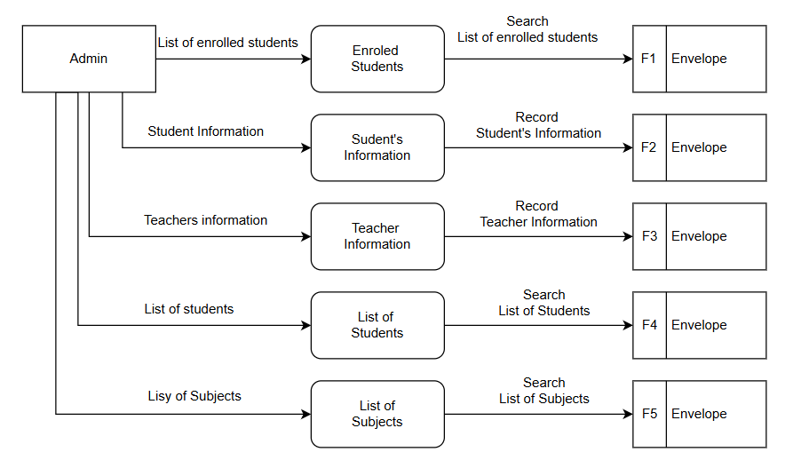
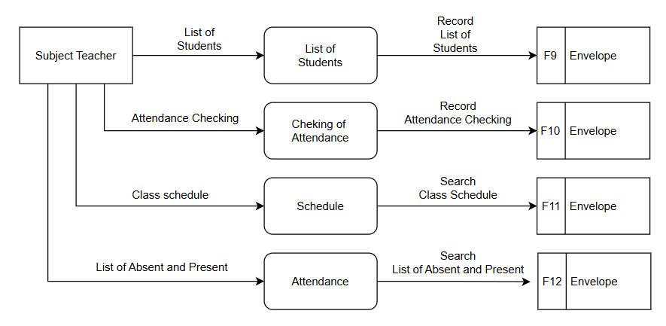
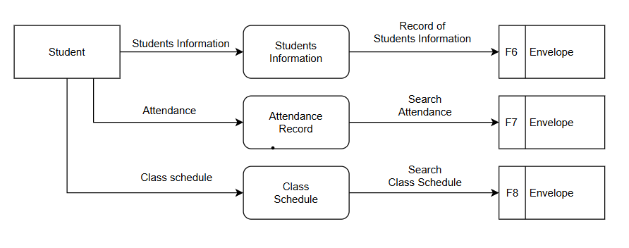
Data Flow Diagram (Existing System)

Slide 15
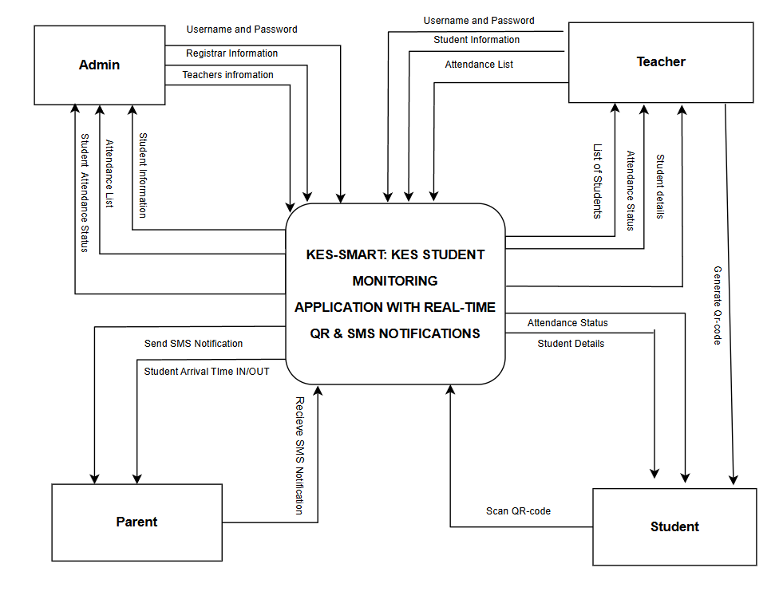
Context Diagram (Proposed System)

Slide 16
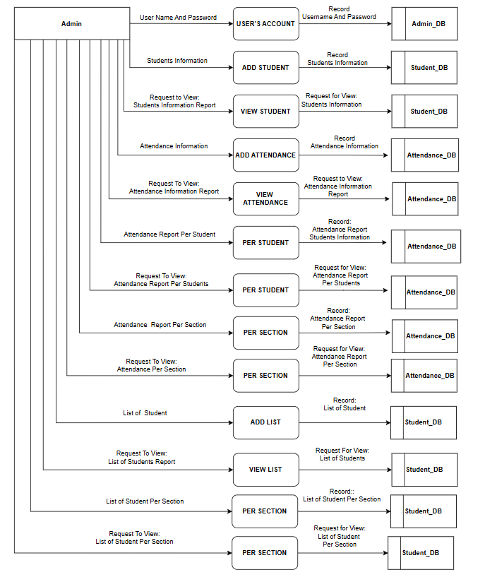
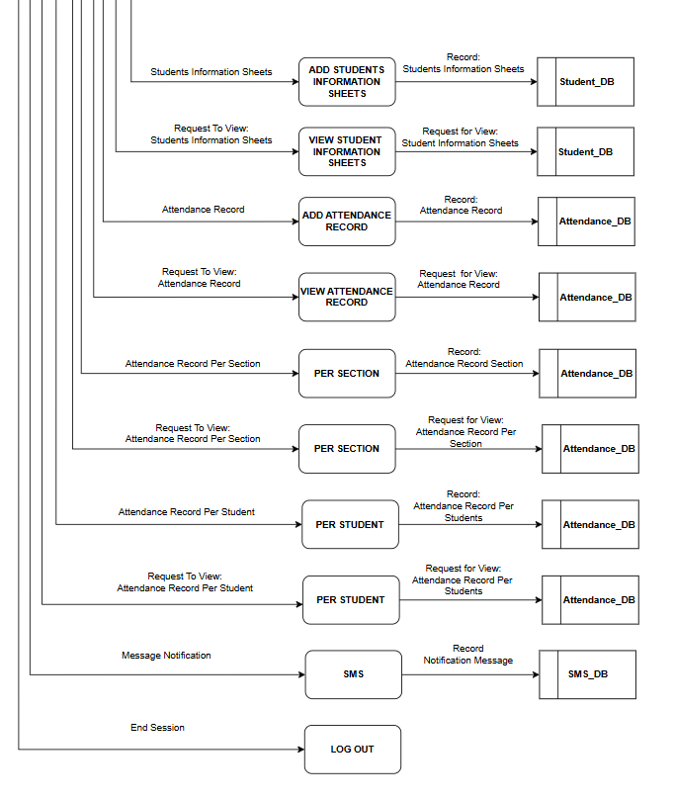
DATA FLOW DIAGRAM (Logical) admin

Slide 17
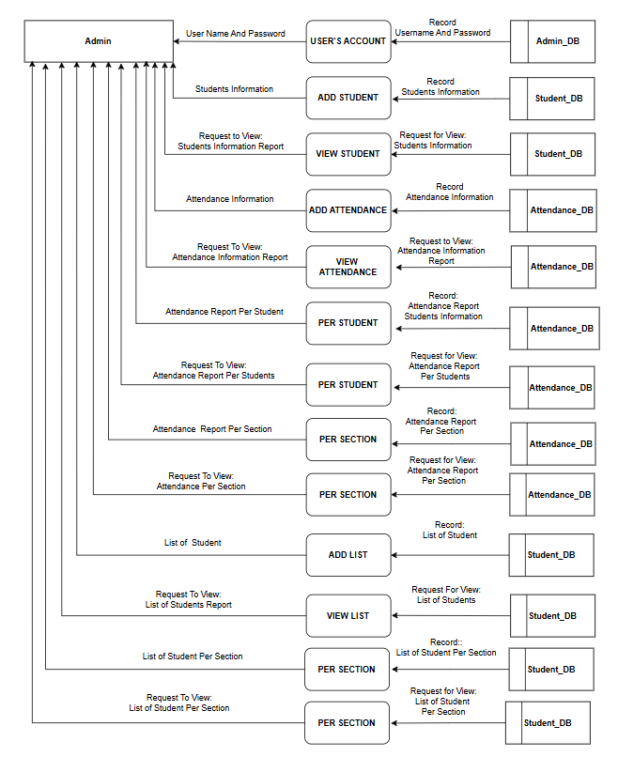
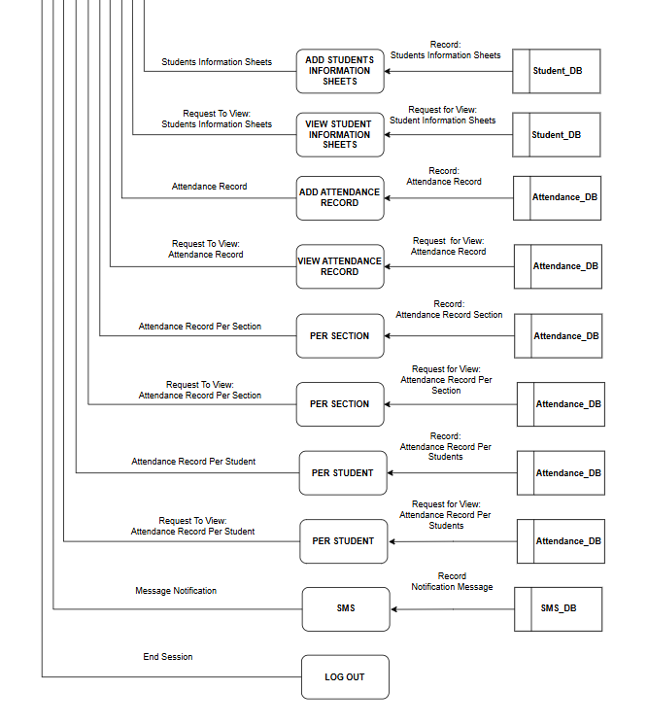
CONTINUED…

Slide 18
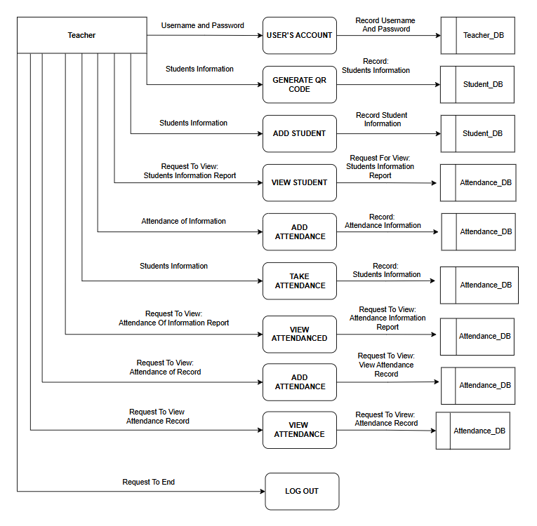
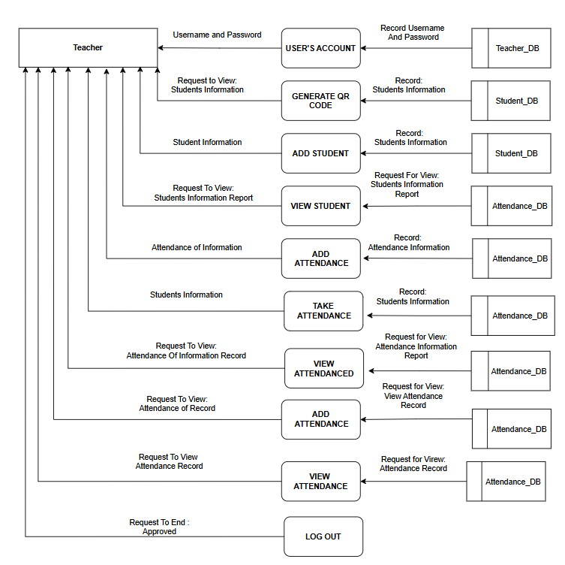
TEACHER
CONTINUED…

Slide 19
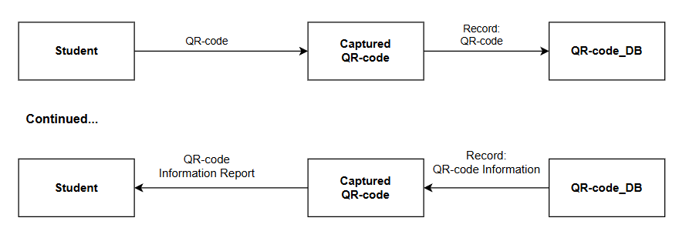
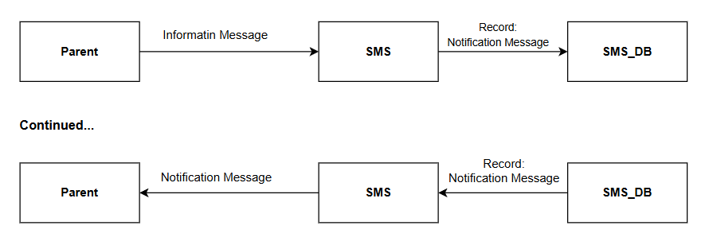
STUDENT
PARENT

Slide 20
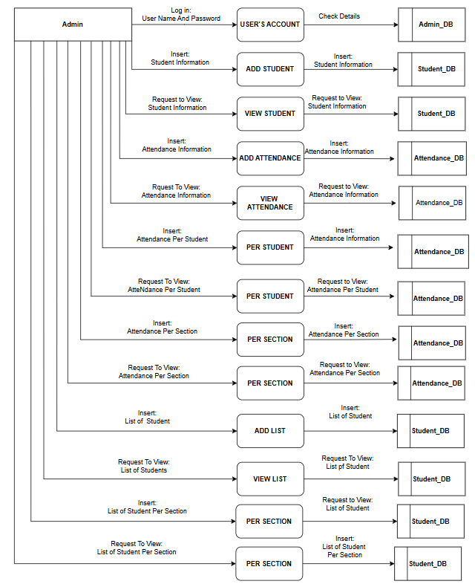
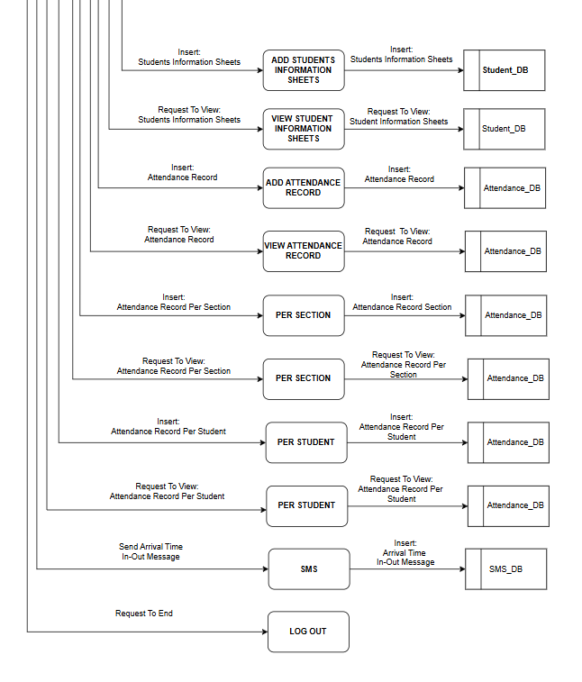
DATA FLOW DIAGRAM (PHYSICAL) ADMIN

Slide 21
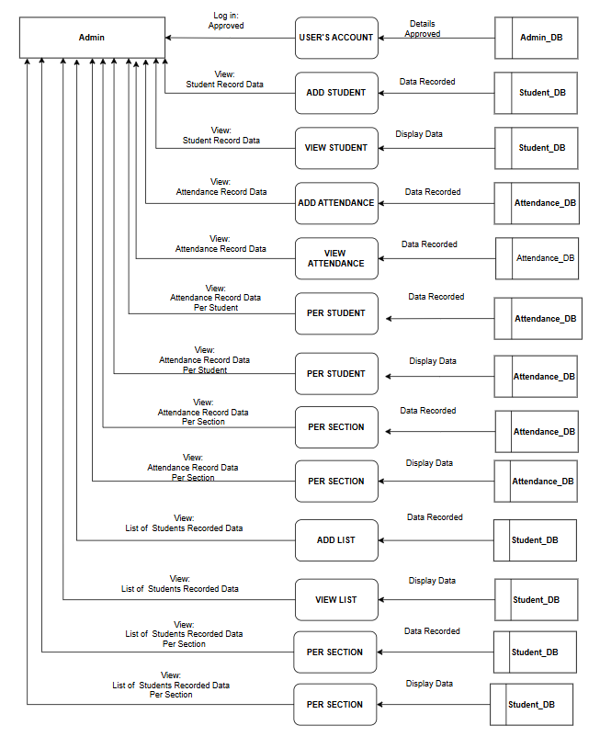
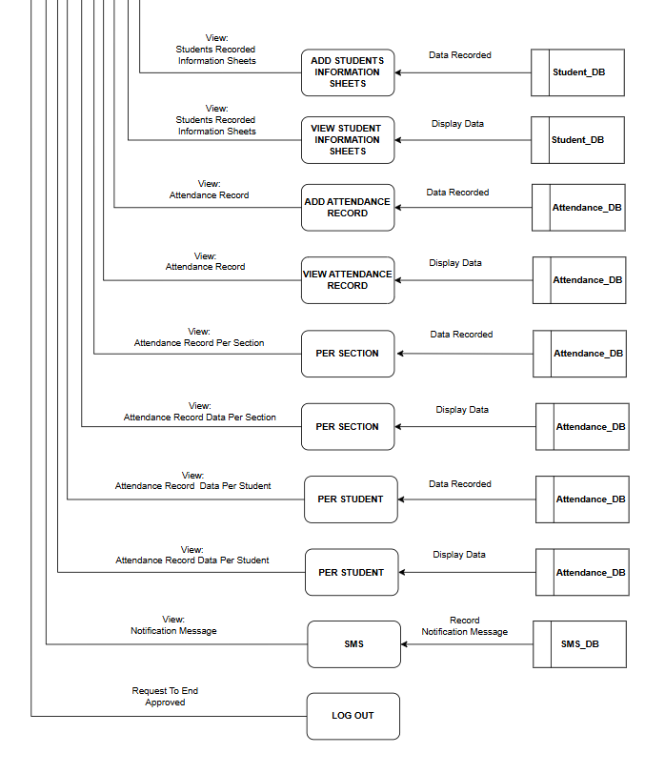
CONTINUED…

Slide 22
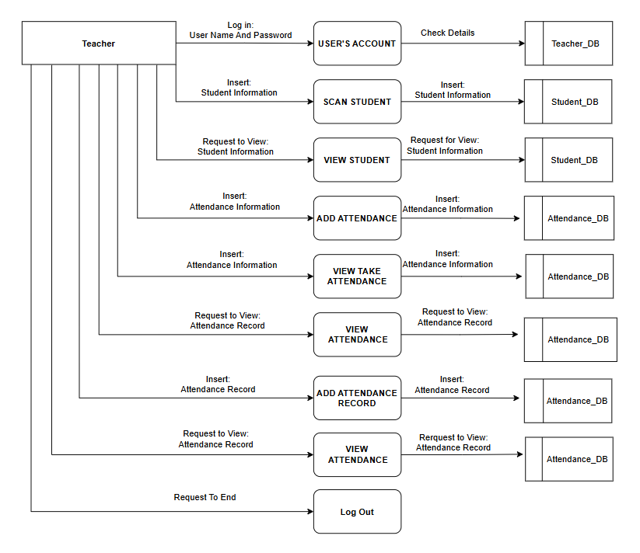
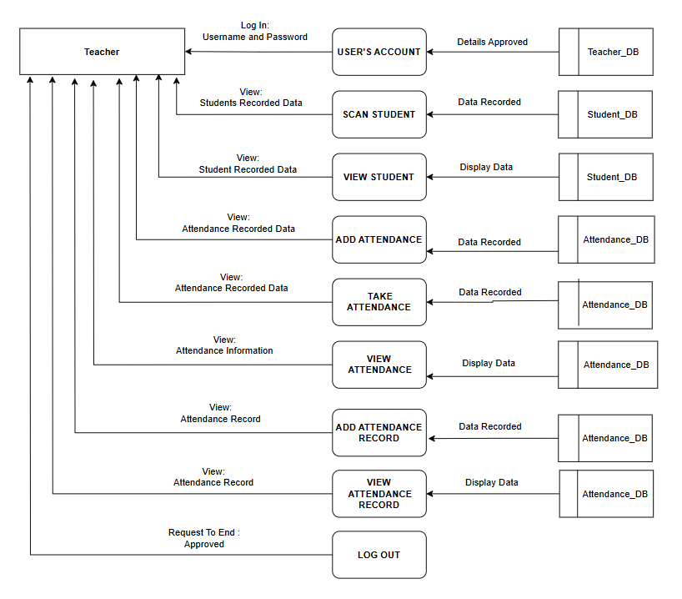
TEACHER
CONTINUED…

Slide 23
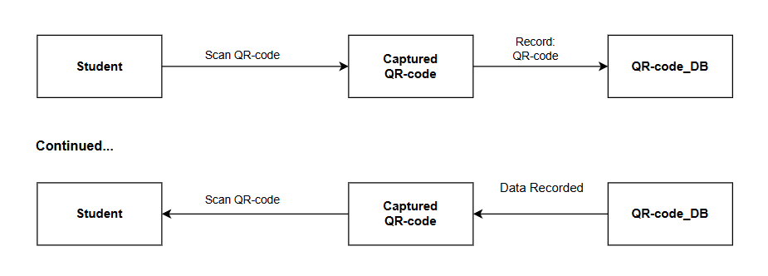
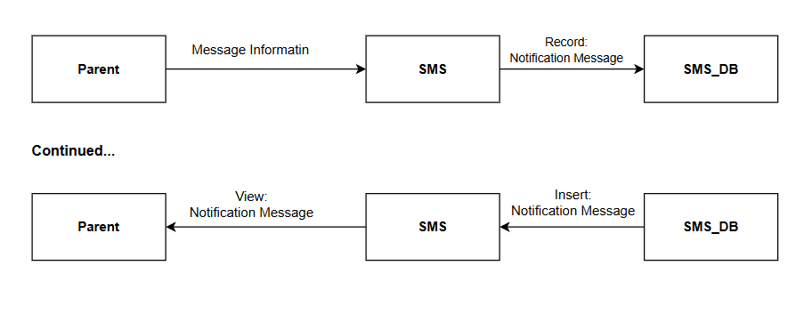
STUDENT
PARENT

Slide 24
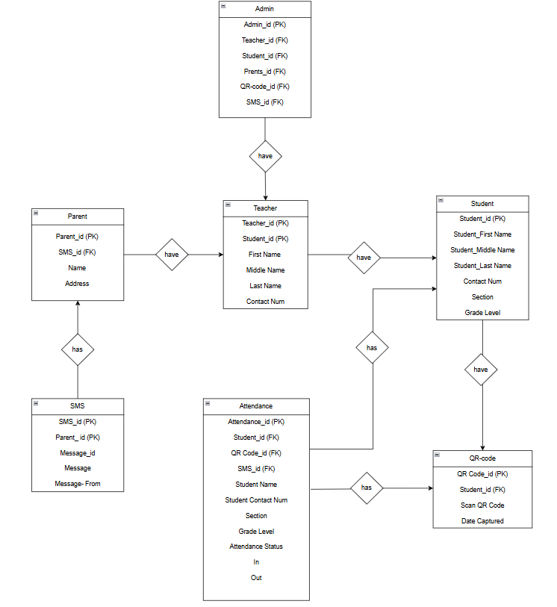
Entity-Relationship Diagram (ERD)

Slide 25
Research Design
This study will be used the descriptive method of research to evaluate the systems functionality in attaining its objectives, accessibility, acceptability of the system, accuracy delivering the outputs, and security of the system users.
Participants of the Study
The respondents of the study were composed of students from grade 1 to grade 6 in Kalandagan Elementary School.

Slide 26
THANK YOU!!

